Slide 1
Week 6 Capstone
By: Zackary Siddiqi

Slide 2



Major Update: PROJECT CHANGE
Moved to a project with DBMS, MySQL and Java
  Why? Previous project was a little too ambitious for me. Needed to learn everything from scratch. It required a lot of web development knowledge.
  Whereas with this C.R.U.D. application, I’m working with tools and languages I have experience with from previous course.
  Another reason: I am more passionate about building this project. It is something I want to actually use and be proud of.

Slide 3
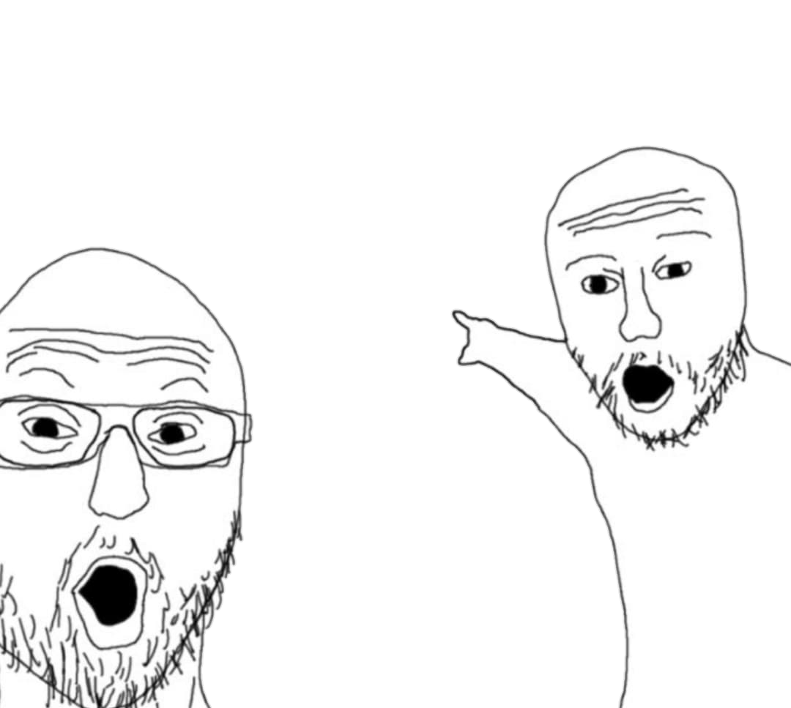

New Project: Graduate Application Dashboard System (G.RA.D.S.)
What is it?: App that allows users to organize and track their Graduate/Undergrad applications on a interactive dashboard.
For this case, it’s Graduate School Applications.
Clean, user friendly UI
Store documents, displays application status (ie. incomplete , in-progress, etc.)
Can Filter dashboard based on the status, URL to program’s course website
Unique features: stats corner - countdown feature for deadlines
and application periods, and summery view

Slide 4
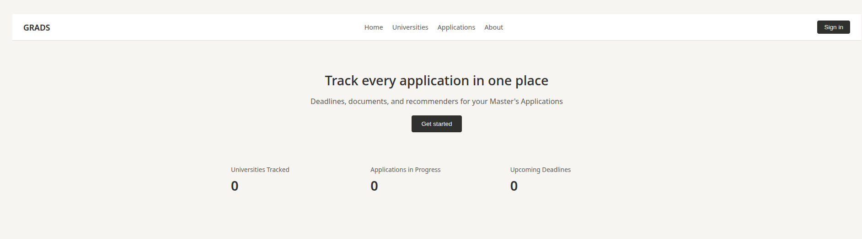
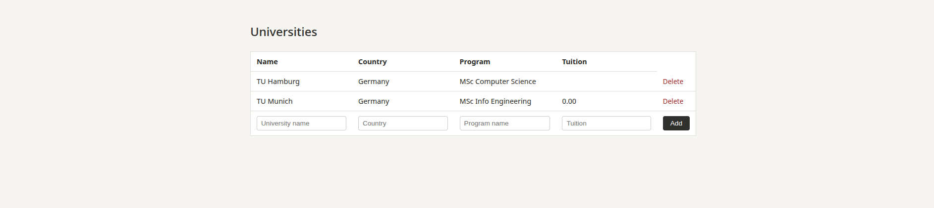
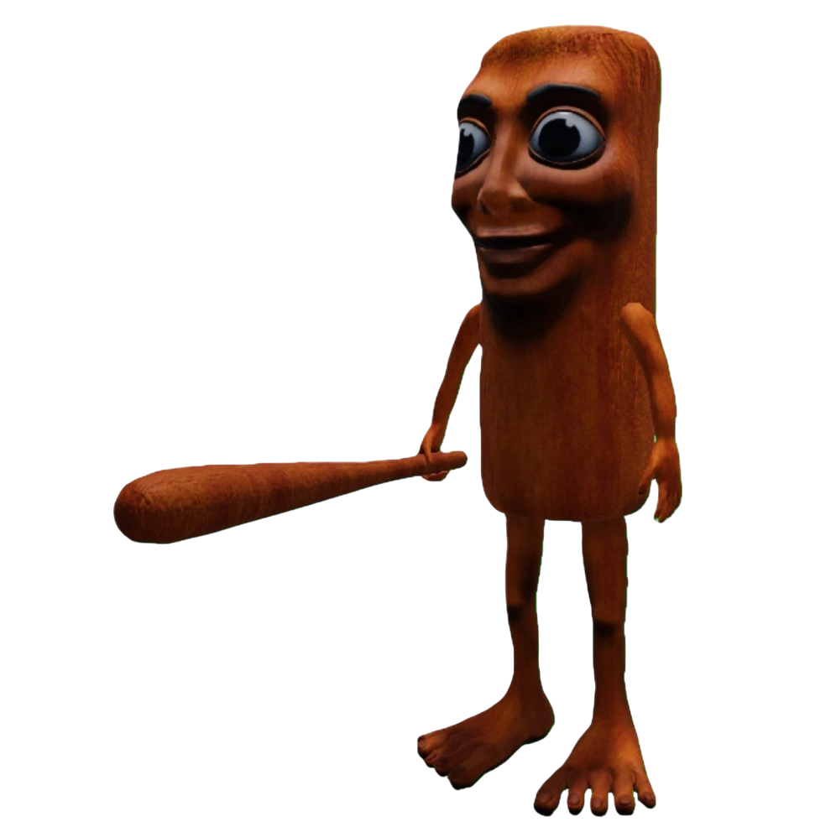
Working UI of GR.A.D.S.

